Slide 1
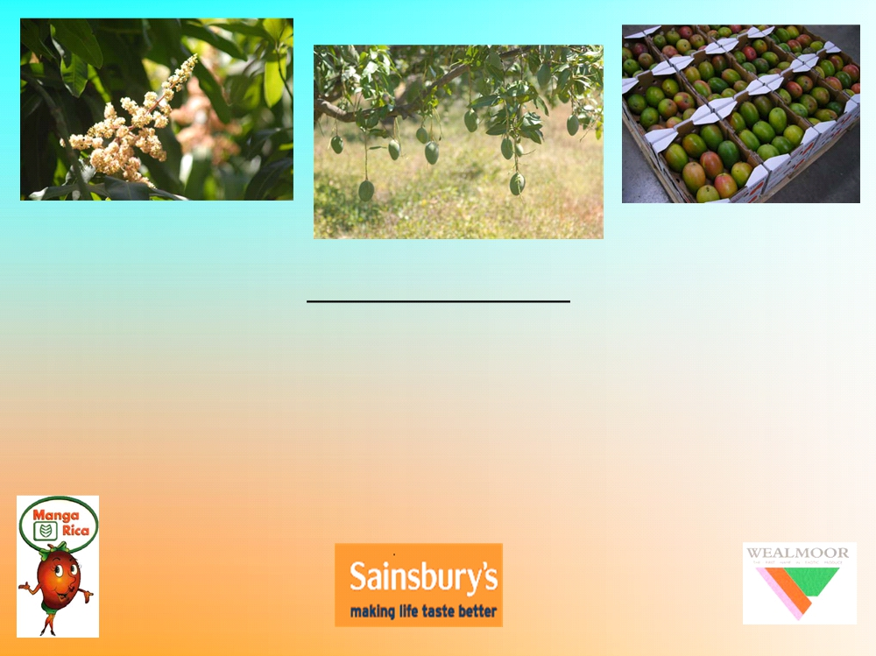
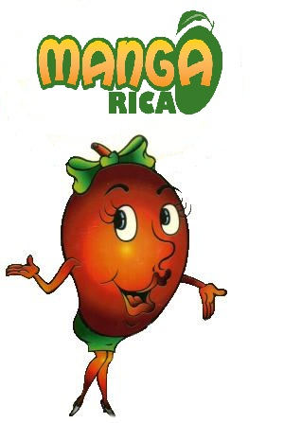
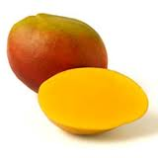
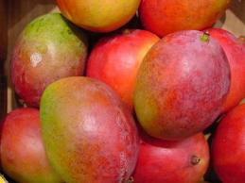
MANGARICA
LIBERIA GUANACASTE COSTA RICA
04 junio 2015

Slide 2

MANGARICA GENERAL BACK-GROUND
1
MANGARICA was founded in 1989 by planting 517 Ha of mangoes. With the aim
to develop fresh mango export to USA and Europe.
2
MANGARICA is primary producer and processor/exporter of fresh mango.
3
In 1998 the pack-house was mechanised introducing the "Fomesa machineries" alongside
a pre-cooling and cooling system.
4
In 1998 start to evaluate the variety Keitt on the European market; and start to reduce
the variety of Haden and Irwin which were loosing interest in the market.
5
MANGARICA with >6,500tons/year is the largest mango operation in Costa Rica and
one of the largest in all Central America
6
MANGARICA is part of the group Montecristo

Slide 3
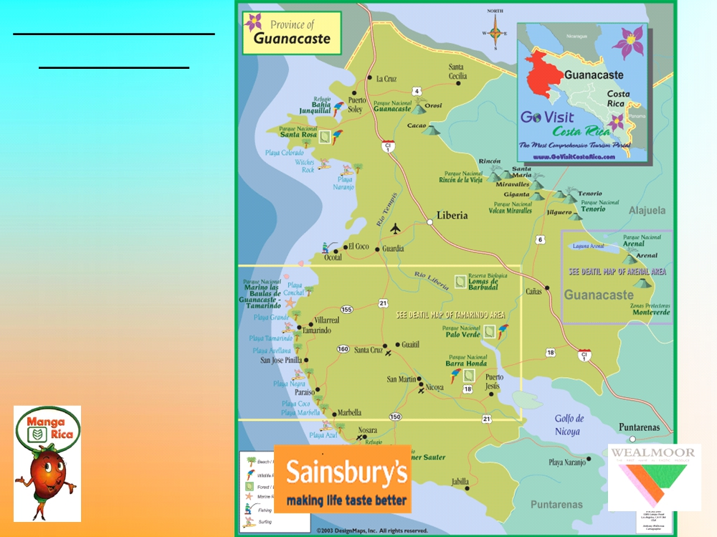
GEOGRAFICAL
LOCATION:
-Costa Rica
-Guanacaste
-Liberia
-Barrio La Cruz

Slide 4

THE GUANACASTE AREA
-It is an area of 10 141 sq.km with a population of 280 488.
-The weather is warm and dry with average temperature of 32C.
-Liberia is the capital city with a population of 48 000 people. It is about 144 Meter a.s.l.
-Guanacaste is one of the largest and least populated province of Costa Rica and also the driest.
-The area has become a popular destination of American holiday makers.
-Also many Americans are investing in properties and the prise of land and houses has increased.
-With about 65 inches of rain a year, this region is by far the driest in the country.
-Guanacaste province sits on the west site (Pacific Ocean) and the border of Nicaragua.
- In addition to cattle ranches, Guanacaste boasts semi active volcanoes, several lakes, and one of the last remnants of tropical dry forest left in Central America (dry forest once stretched all the way from Costa Rica up to the Mexican state of Chiapas).

Slide 5
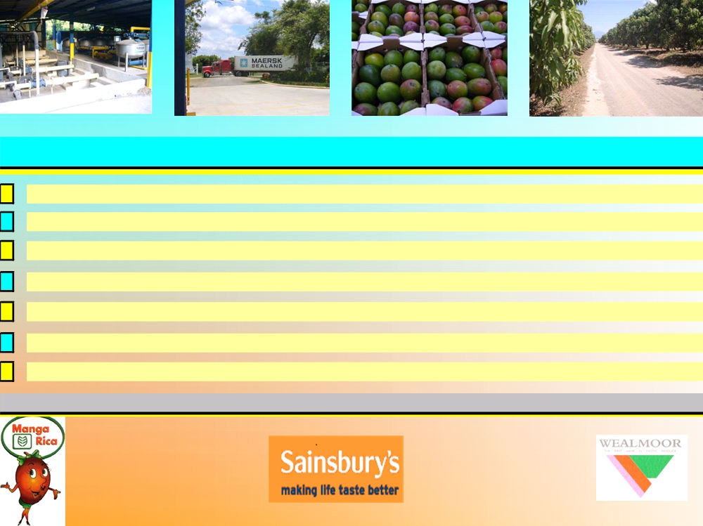
MANGARICA GENERAL OVERVIEW OF OPERATION
517 Hectares in only one farm plot- divided in 16 lots
All equipped with modern fertirrigation system per aspersion All land is orography plane: easy access, work and transit
All lots are of similar soil profile and climatic condition- for better management Isolated farm (no farming neighbours): no risk for cross contamination Close to small town/village for sourcing labours, and various assistance

Slide 6
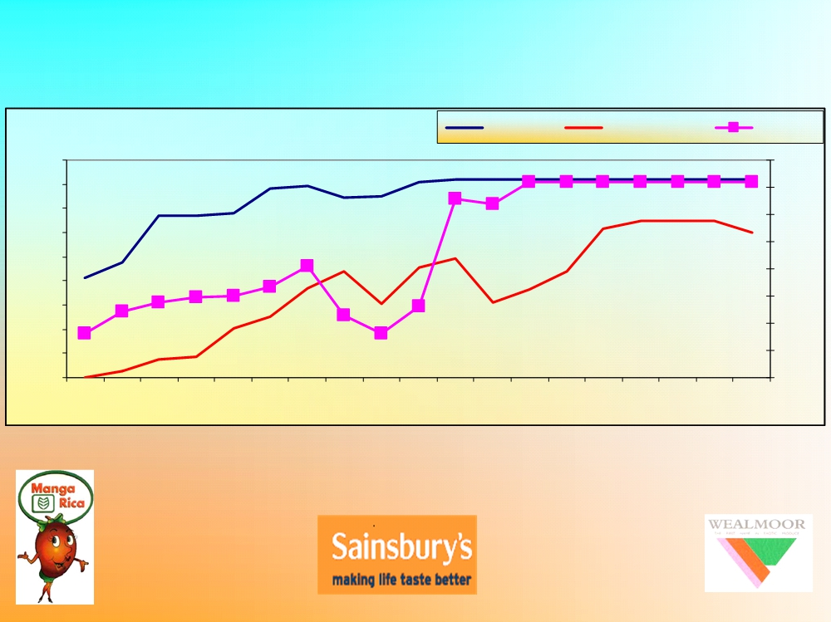
OVERVIEW OF COSTA RICA MANGO INDUSTRY
Costa Rica Mango Industry
Area-Ha-
Export (tons)
Prod.-Mt
9,000
40,000
8,000
35,000
7,000
30,000
6,000
25,000
5,000
20,000
4,000
3,000
15,000
2,000
10,000
1,000
5,000
0
0
199019911992
1993199419951996
1997199819992000
2001200220032004
2005200620072008

Slide 7


MANGA RICA IN THE MARKET

Slide 8

MANGARICA PERSONNEL STRUCTURE
ANDRES MEDINA VARGAS
(General
Manager)
EDWIN RODRIGUEZ B
JESUS GUIDO C
Carlos Guevara
MARCOS MORERA
(administrator
(pack-house mgr)
(farm manager)
(export/logistic/
chief/personnel)
technical)

Slide 9
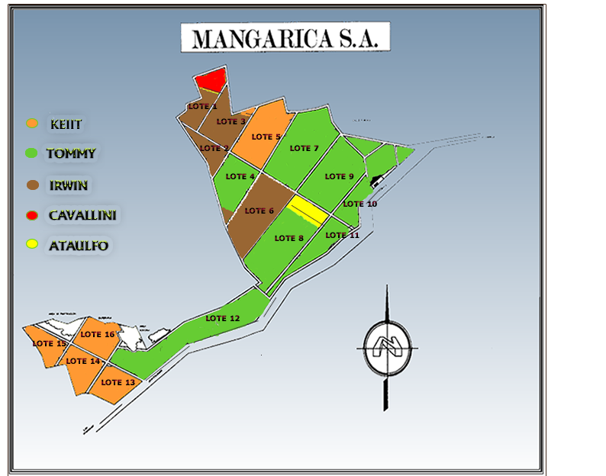

Slide 10
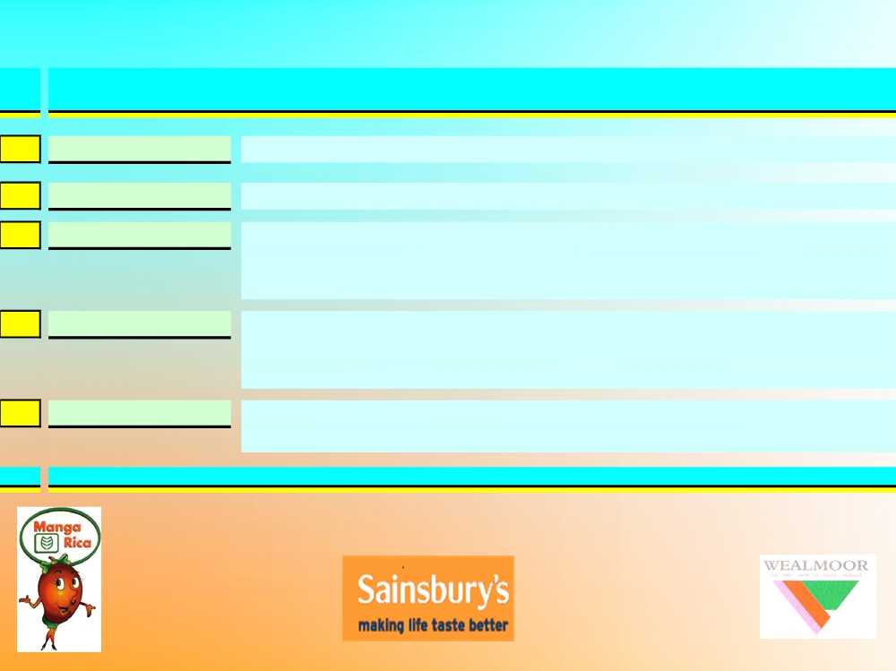
MANGARICA's Principles of Operation
Highest quality tailored to customer requirements Production is in sintony with local environment.
1 PRODUCT
2 PROTECTION OF ENVIR.
3 PEOPLE
Working with the local community to build up strong relation with locals and employers. As well as having strong relation and tradition with the Nicaraguan community for seasonal jobs.
4 PASSION & PRIDE
MANGARICA is a successful business in the local reality, its reputation is well establish among the local community as well as among the mango receivers in USA and Europe
5 PRINCIPLE & STANDARD
Providing a sustainable, principled and profitable business whilst operating within the highest standards -

Slide 12
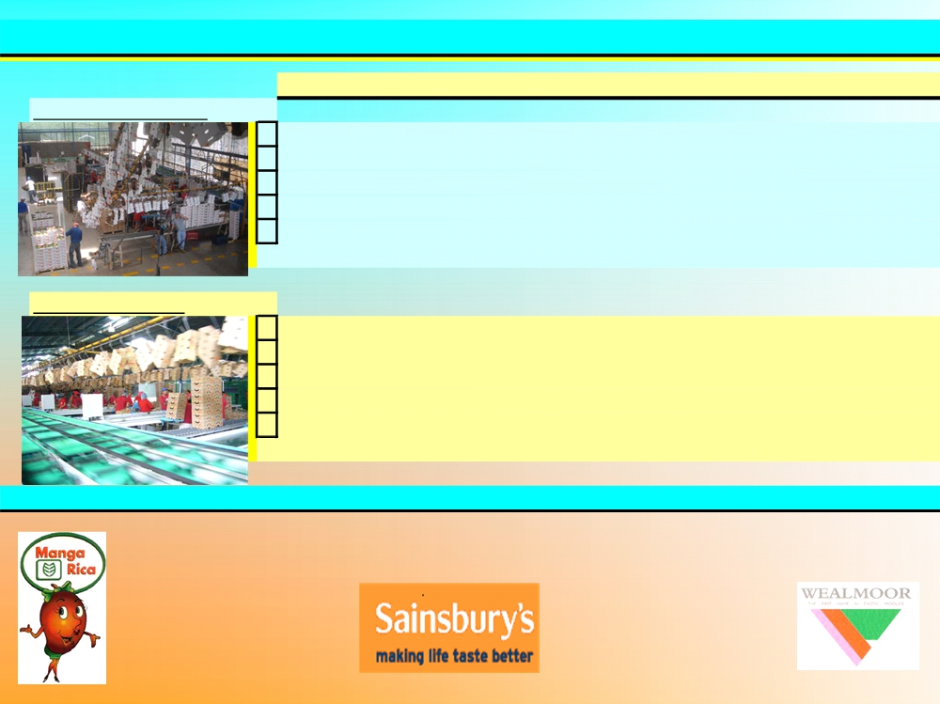
MANGARICA PACKING HOUSES FACILITIES
Areas
Size
notes
1
Pack-House Europe
1Intake
150 tons
2Washing
10t/hour Fomes machinery 10t/hour Fomesa machinery
3Grading
4Cooling
160 tons pre-cooling for 32 pallets
5Boxing storage
1.5M 1 gluing machine
2 Pack-House USA
1Intake
150 t
2Washing 3Grading 4Cooling 5Boxing storage
10t/hour Fomesa machinery 10t/hour Fomesa machinery 160t pre-cooling for 32 pallets
1.5M 1 gluing machine

Slide 13

INTAKE AREA
Patio de Recibo
PRECOOLING
WASHING
# 1
COOL STORE
# 2
# 3
GRADING
Sizer #1
1
2
3
4
PACKING AREA
5
6
PACKING FOR HWT
7
HOT WATER TREATMENT
8
EUROPEAN AREA

Slide 14

GENERAL SPECIFICATIONS FOR MANGOS
In all classes, subject to the special provisions for each class and the tolerances allowed, the mangoes
must be:
- whole;
- sound, produce affected by rotting or deterioration such as to make it unfit for consumption is excluded;
- clean, practically free of any visible foreign matter;
- practically free of damage caused by pests;
- free of abnormal external moisture, excluding condensation following removal from cold storage;
- free of any foreign smell and/or taste;
- firm;
- fresh in appearance;
- free of damage caused by low temperatures;
- free of black necrotic stains or trails;
- free of marked bruising;
- sufficiently developed and display satisfactory ripeness.
When a peduncle is present, it shall be no longer than 1.0 cm.
The development and condition of the mangoes must be such as to enable them:
- to ensure a continuation of the maturation process until they reach the appropriate degree of maturity
corresponding to the varietal characteristics;
- to withstand transport and handling; and
- to arrive in satisfactory condition at the place of destination.

Slide 15
MANGA RICA`s VARIETIES
TOMMY ATKINS.
KEIT.
IRWIN.
RED HADEN
ATAULFO.

Slide 16
CALIBERS SPECIFICATIONS
Measures expresed in grams.

Slide 17
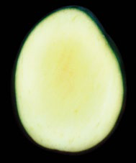

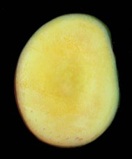
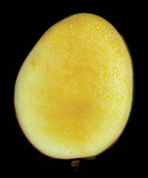
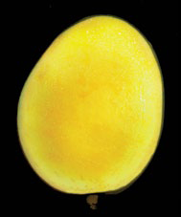
Maturity chart
1 | 2 | 3 | 4 | 5

Slide 18
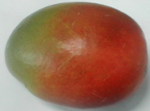
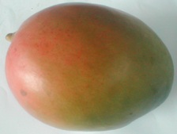
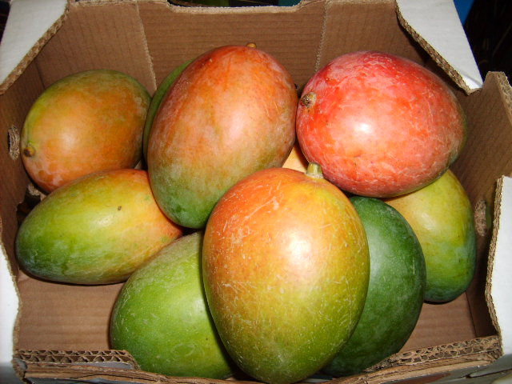
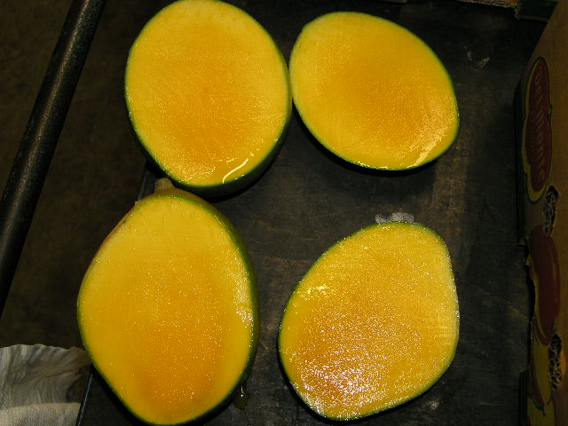
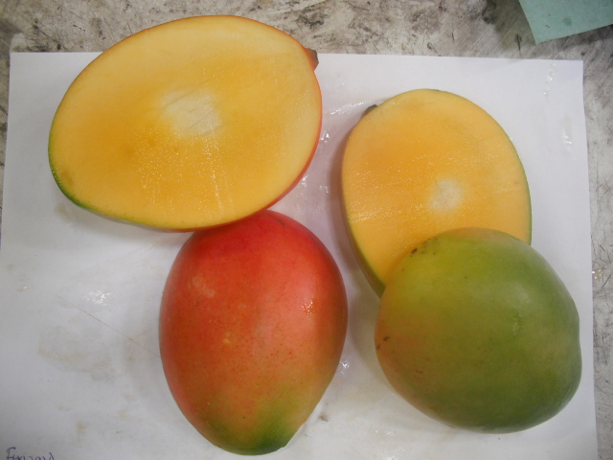
Keitt

Slide 19
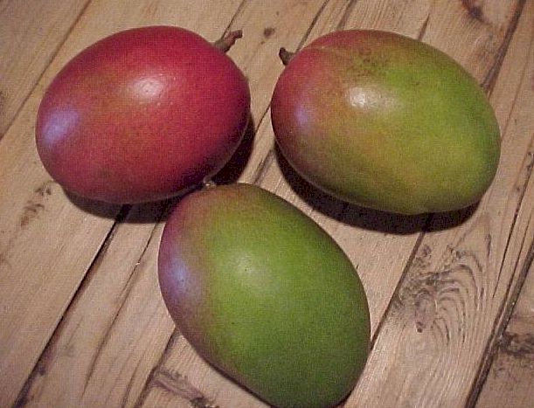
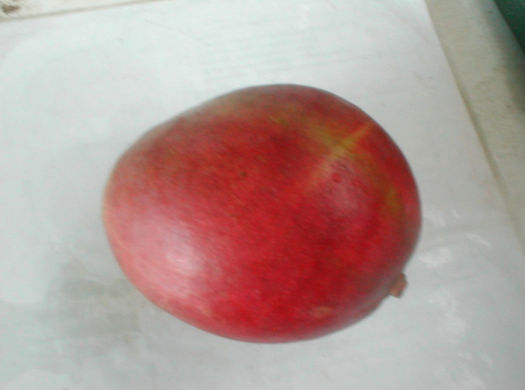
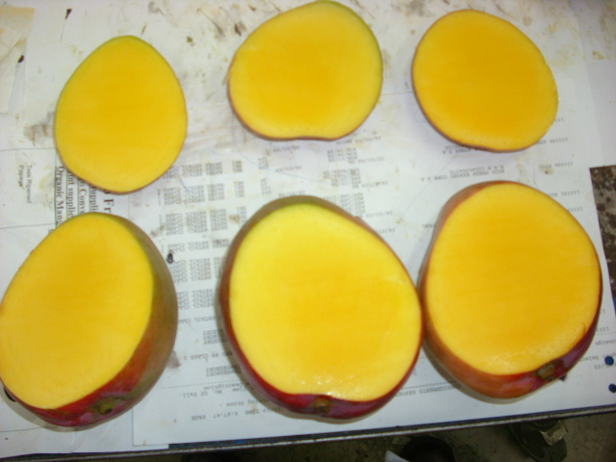
Tommy Atkins

Slide 20
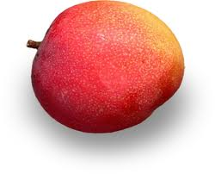
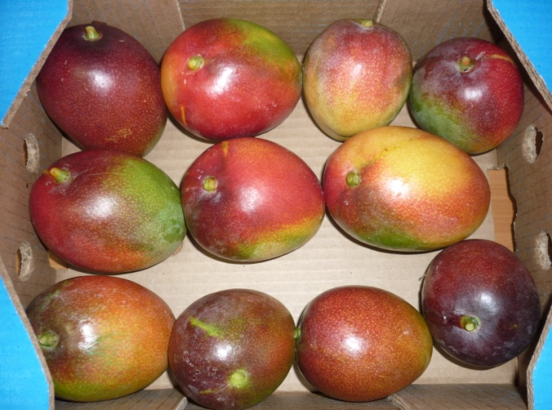
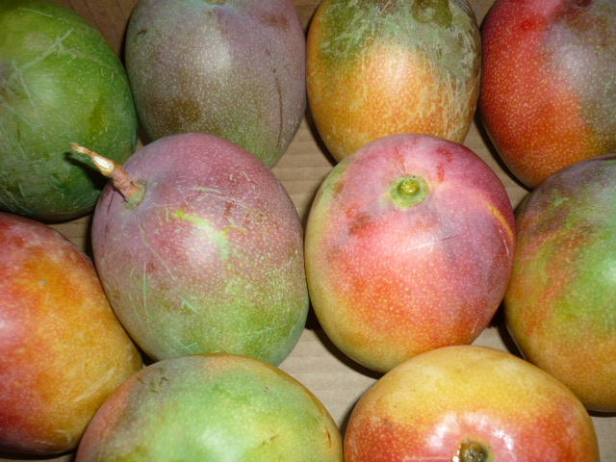
HADEN

Slide 21
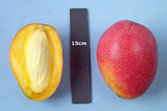
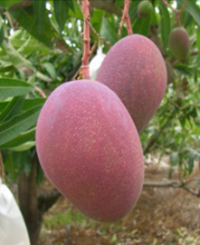
IRWIN

Slide 22

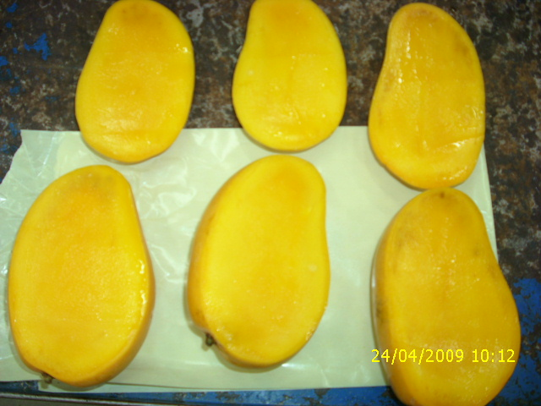
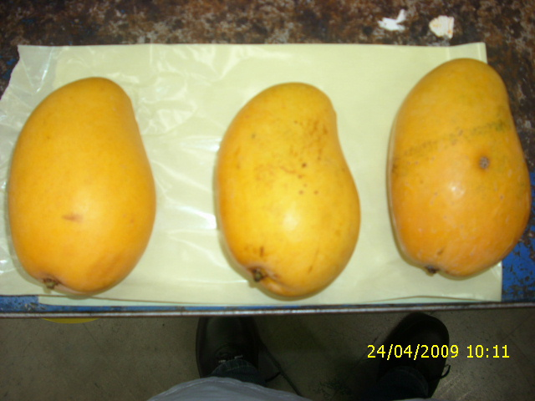
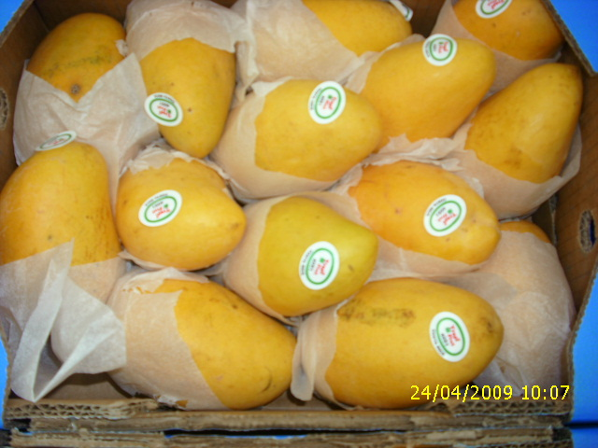
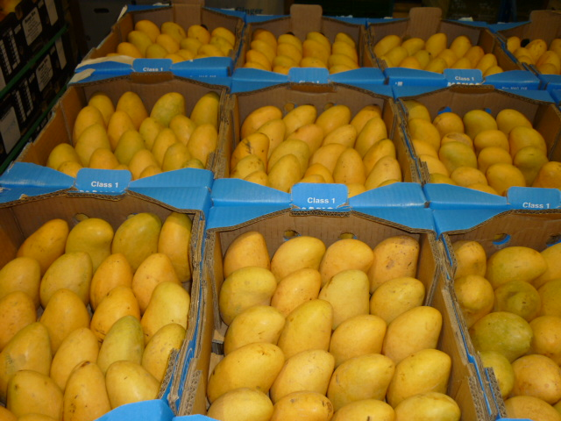
Ataulfo

Slide 23

CALIBERS ATAULFOS
EXPRESSED IN GRAMS

Slide 24

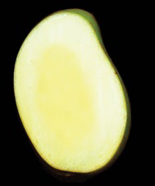
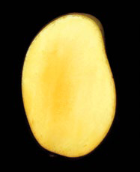
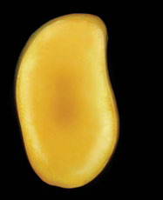
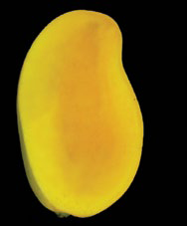
MATURITY CHARTS ON ATAULFOS
1 | 2 | 3 | 4 | 5

Slide 25
History of Manga Rica (boxes 4 Kg)

Slide 26
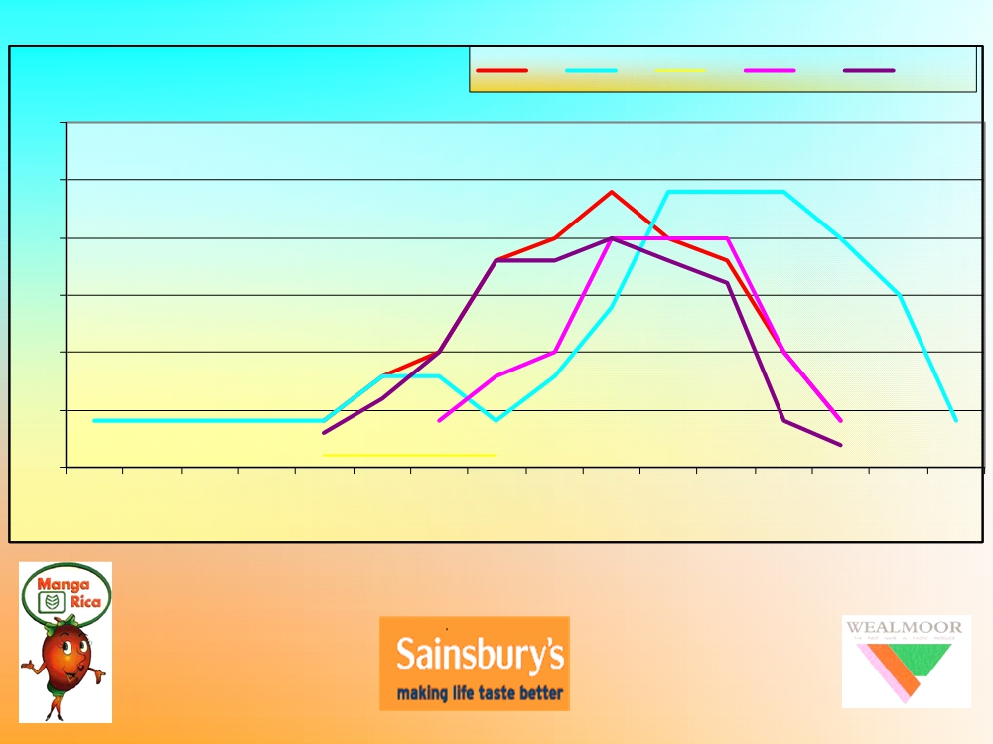
Production per variety
TA KT AT
IR new
300
250 200 150 100
50
0
4
5
6
7
8
9
10
11
12
13
14
15
16
17
18
19

Slide 27







MANGA RICA ACREDITATIONS

Slide 28
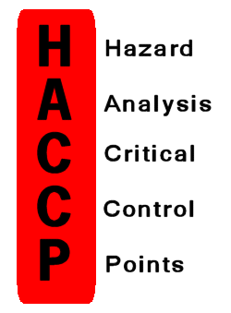


LOOKING FOR MORE ACCREDITATIONS FOR THE COMING SEASON…..

Slide 29
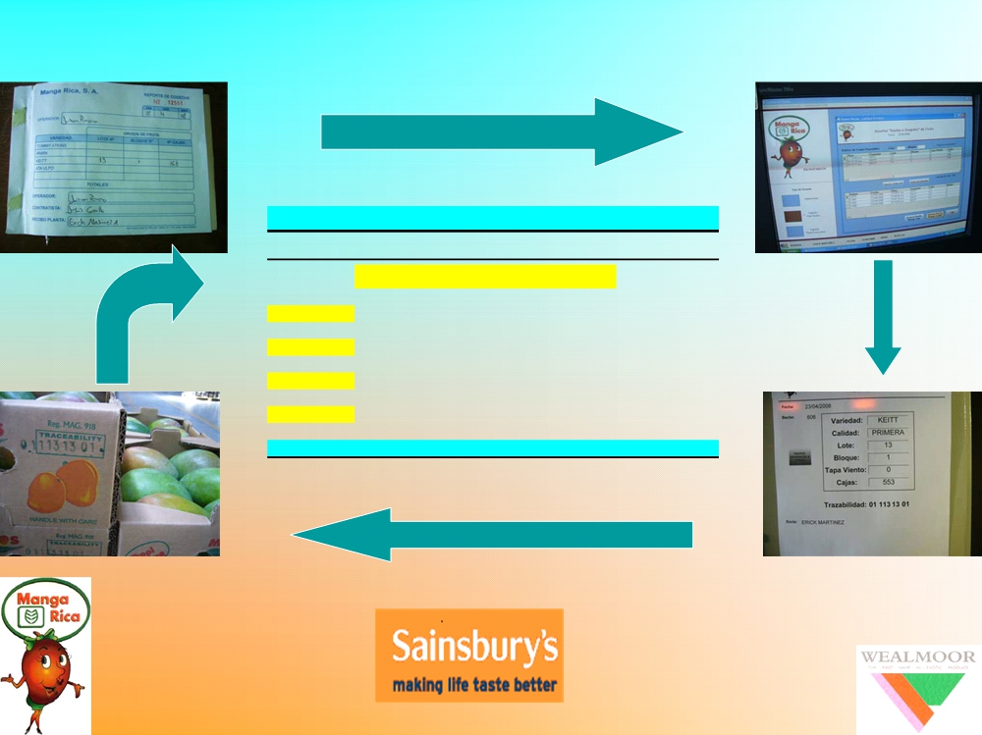
MANGARICA TRACTABILITY SYSTEM
MANGARICA TRACTABILITY SYSTEM
Examples of reading
Code printed
.01-113-13-01
0.01
farm ID (01=Mangarica)
day from the beginning of the year lote 16 block ~6-10 per lote
113
13
0.1

Slide 30

MANGARICA- IN THE LOCAL REALITY
1
Provide direct work for >1000 people.
2
Supports an estimation of 2 000 families.
3
Support the local community through local projects
educational programmes, trainings, support to government Institutions.
4
Provides An example of standard and performance in an area

Slide 31
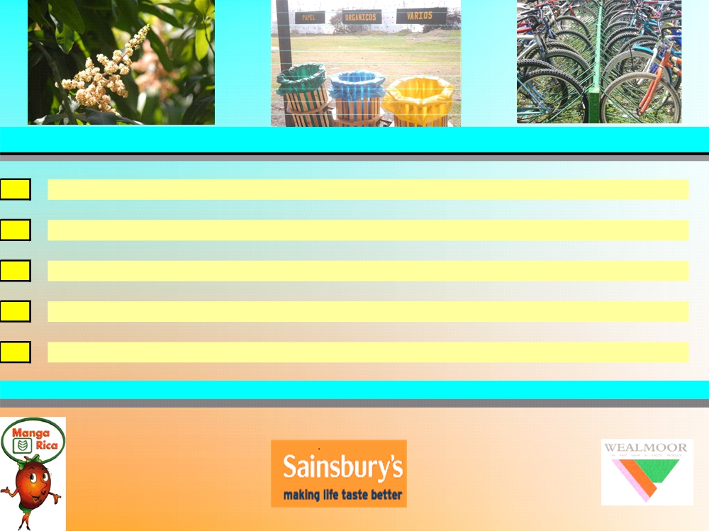
ENVIRONMENTAL RESPONSIBILITIES
1
IPM principles applied across all plantations
2
Recycling policy of waste material largely employed across the operation
3
Large areas of farms have being re-forested
4
Buffer zones and green corridors well respected
5
Pesticide storage and handling carried out according to the principle of code of good practice

Slide 32
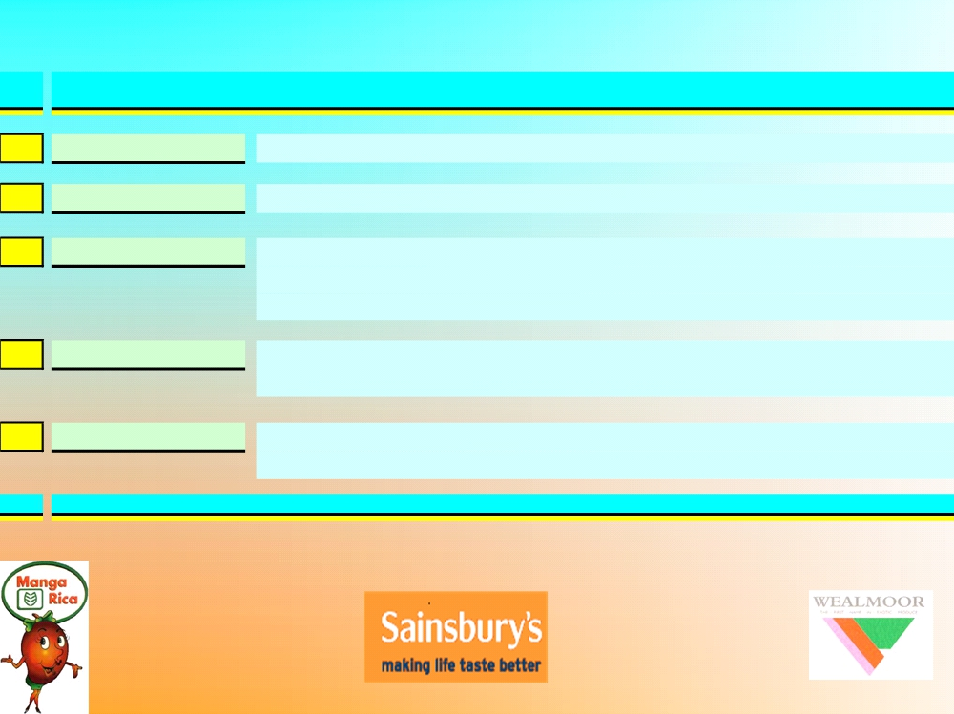
MANGARICA SOCIAL RESPONSIBILITIES -THE LOCAL COMMUNITY
Free training and up-grade courses for employers. Finance programme for developing drainage infrastructure.
1 Employers
2 Association of development
3 SCHOOL
Support a primary school scheme in La Cruz for children from families having financial difficulties.
32$/month X school children all year around.
4 Local Communities
Donation of fruits to hospitals, house for elders, orphanage, prisoners, schools and colleges.
5 LIBERIA Town Hall
Finance programmes to construct and repair roads and drainage infrastructure.

Slide 33
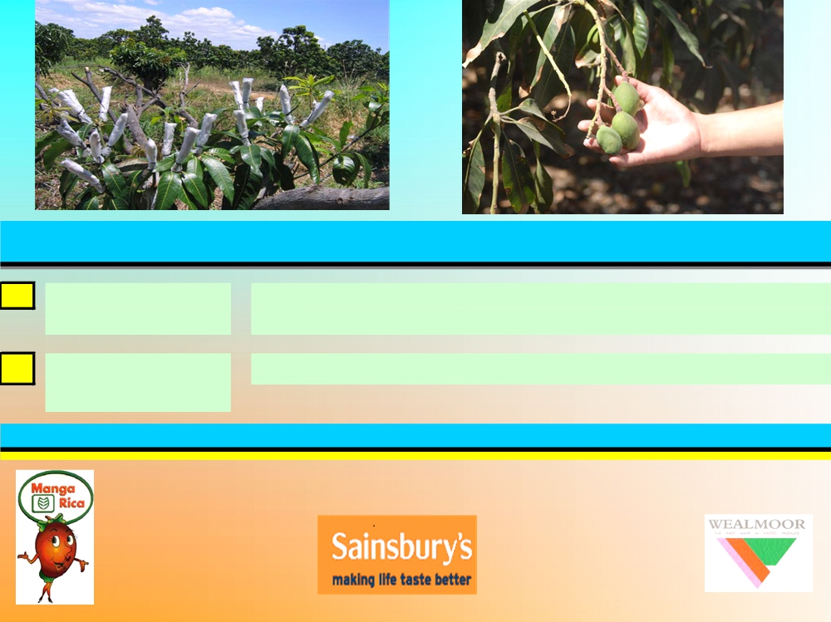
MANGARICA DEVELOPMENTS
1
IRWIN variety Up to 100 Ha of IRWIN variety are under re-graphted
Re-Graphted
programme into Tommy and Keitt
2
PACK HOUSE
Project the enlarge the packing and storage facilities
(Enlargement)

Slide 34

MANGARICA EXTERNAL PARTNERS
EARTH UNIVERSITY
Process and marketing of about 300 tons/year Technical assistance
Production support Training support

Slide 35

HOW MANGARICA REDUCE CHEMICAL APPLICATIONS
Location: dry and windy
Disposition of the plantation-orientation and set distances Varieties selected
Systematic pruning to improve ventilation and reduce humidity.
Hygienic practices like control of the grass etc, always carried out mechanically Good training of personnel which apply chemicals
Good maintenance, calibration and upgrade of spaying machineries Detailed monitoring of diseases and insects (tramps).
Use of only permitted chemical in Costa Rica and country of the destination of the product. Good practice in storage and handling.

Slide 36
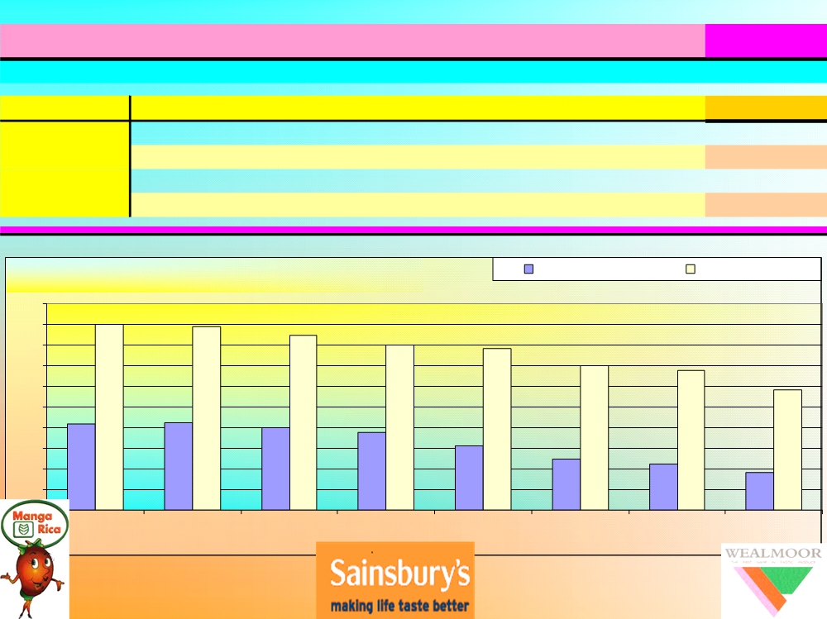

MANAGARICA chemical application: year 2003-2011

Slide 37
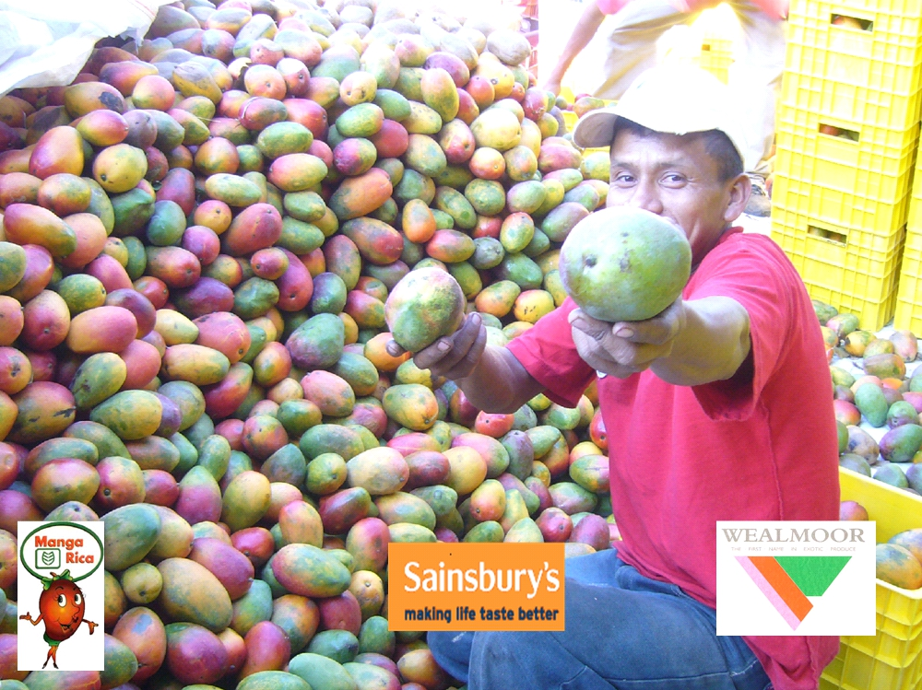

…have a mango
…..and
..many thanks

